Slide 1
1. Main Screen Configuration – All Channels
Caption Bar
All channel monitoring
Media & CG & Input
Schedule Event Controller
12:00:00
Setting
-
X
All
Channel 1
Channel 2
Media
CG
Input
PGM
No | Type | Start Time | Duration | Title | Media | Device | Status
1 | T | 2017/05/24 10:00:00:00 | 00:30:00:00 | Title1 | P201703300001.mxf | Media1 | DONE
2 | S | 2017/05/24 10:30:00:00 | 00:25:00:00 | Title2 | P201703300002.mxf | Media1 | DONE
3 | S | 2017/05/24 10:55:00:00 | 00:20:00:00 | Title3 | P201703300003.mxf | Media1 | ONAIR
4 | S | 2017/05/24 11:00:00:00 | 00:05:00:00 | Title4 | P201703300004.mxf | Media1 | CUED
5 | S | 2017/05/24 11:05:00:00 | 00:30:00:00 | Title5 | P201703300005.mxf | Media1
Time Panel
Time line
PGM
No | Type | Start Time | Duration | Title | Media | Device | Status
1 | T | 2017/05/24 10:00:00:00 | 00:30:00:00 | Title1 | P201703300001.mxf | Media1 | DONE
2 | S | 2017/05/24 10:30:00:00 | 00:25:00:00 | Title2 | P201703300002.mxf | Media1 | DONE
3 | S | 2017/05/24 10:55:00:00 | 00:20:00:00 | Title3 | P201703300003.mxf | Media1 | ONAIR
4 | S | 2017/05/24 11:00:00:00 | 00:05:00:00 | Title4 | P201703300004.mxf | Media1 | CUED
5 | S | 2017/05/24 11:05:00:00 | 00:30:00:00 | Title5 | P201703300005.mxf | Media1
Time Panel
Time line
PGM screen
PGM time
information
PGM schedule list
PGM schedule time line

Slide 2
2. Main Screen Configuration – 1 Channels
PGM screen
1 Channel monitoring
Schedule Event Controller
12:00:00
Setting
-
X
All
Channel 1
Channel 2
Media
CG
Input
PGM
No | Type | Start Time | Duration | Title | Media | Device | Status
1 | T | 2017/05/24 10:00:00:00 | 00:30:00:00 | Title1 | P201703300001.mxf | Media1 | DONE
2 | S | 2017/05/24 10:30:00:00 | 00:25:00:00 | Title2 | P201703300002.mxf | Media1 | DONE
3 | S | 2017/05/24 10:55:00:00 | 00:20:00:00 | Title3 | P201703300003.mxf | Media1 | ONAIR
4 | S | 2017/05/24 11:00:00:00 | 00:05:00:00 | Title4 | P201703300004.mxf | Media1 | CUED
5 | S | 2017/05/24 11:05:00:00 | 00:10:00:00 | Title5 | P201703300005.mxf | Media1
6 | S | 2017/05/24 11:15:00:00 | 00:10:00:00 | Title6 | P201703300006.mxf | Media1
7 | S | 2017/05/24 11:25:00:00 | 00:30:00:00 | Title7 | P201703300007.mxf | Media1
8 | S | 2017/05/24 12:05:00:00 | 00:25:00:00 | Title8 | P201703300008.mxf | Media1
8 | S | 2017/05/24 12:30:00:00 | 00:20:00:00 | Title9 | P201703300009.mxf | Media1
10 | S | 2017/05/24 12:50:00:00 | 00:05:00:00 | Title10 | P201703300010.mxf | Media1
11 | S | 2017/05/24 13:00:00:00 | 00:10:00:00 | Title11 | P201703300011.mxf | Media1
12 | S | 2017/05/24 13:10:00:00 | 00:10:00:00 | Title12 | P201703300012.mxf | Media1
13 | S | 2017/05/24 13:20:00:00 | 00:10:00:00 | Title13 | P201703300013.mxf | Media1
14 | S | 2017/05/24 13:30:00:00 | 00:10:00:00 | Title14 | P201703300014.mxf | Media1
Time Panel
PST
Time line
PST screen
PGM time
information
PGM schedule time line

Slide 3

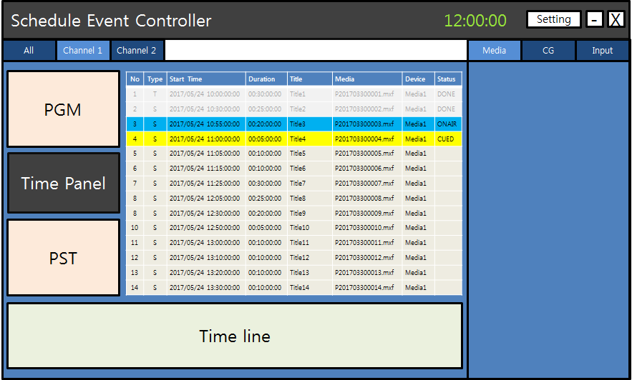

3. Media Configuration
Media preview & track bar
Media
CG
Input
D:\Media\MXF\P201703300001.mxf
Current media name
Media current time
00:00:21:15
Media playback control
Current selected media folder
Folder
Folder name
File Name | Duration | Path
P201703300001.mxf | 00:30:00:00 | D:\Media\MXF
P201703300002.mxf | 00:25:00:00 | D:\Media\MXF
P201703300003.mxf | 00:20:00:00 | D:\Media\MXF
P201703300004.mxf | 00:05:00:00 | D:\Media\MXF
P201703300005.mxf | 00:10:00:00 | D:\Media\MXF
Media list

Slide 4

4. CG Configuration
CG preview
Media
CG
Input
D:\Media\MXF\P201703300001.mxf
Current CG name
Current selected CG layer
1
2
3
Current selected CG folder
Folder
Folder name
File Name | Duration | Path
P201703300001.mxf | 00:30:00:00 | D:\Media\MXF
P201703300002.mxf | 00:25:00:00 | D:\Media\MXF
P201703300003.mxf | 00:20:00:00 | D:\Media\MXF
P201703300004.mxf | 00:05:00:00 | D:\Media\MXF
P201703300005.mxf | 00:10:00:00 | D:\Media\MXF
CG list

Slide 5
5. Input Configuration
CG preview
Media
CG
Input
Video & Audio device name
Current input device name
Input information
Input information

